Slide 1
Milestone - 3

Slide 2
Milestone 3 (Weeks 5–6) – CRM Integration & Conversation Intelligence
• Integrate CRM systems and sales workflows.
• Implement meeting and sales conversation summarization.
• Develop FastAPI endpoints for external integrations.

Slide 3
Objective
Build an AI-powered system that:
Connects with CRM platforms.
Stores customer and sales information.
Summarizes sales meetings automatically.
Extracts insights from conversations.
Provides FastAPI endpoints for external applications.

Slide 4
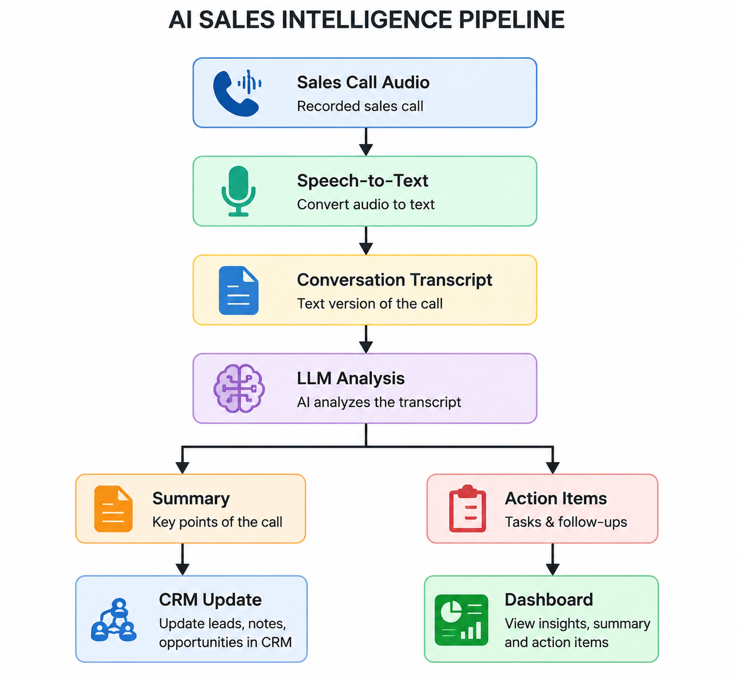
Architecture

Slide 5
Part 1: CRM Integration
Step 1: Install Required Packages
pip install fastapi uvicorn requests sqlalchemy

Slide 6
Step 2: Create CRM Database Model
from sqlalchemy import Column, Integer, String
from database import Base
class Customer(Base):
__tablename__ = "customers"
id = Column(Integer, primary_key=True)
name = Column(String)
email = Column(String)
company = Column(String)
status = Column(String)

Slide 7
Explanation
Stores:
Customer Name
Email
Company
Lead Status
Example:
Name: John
Company: Microsoft
Status: Interested

Slide 8
Step 3: Create CRM Service
customers = []
def add_customer(data):
customers.append(data)
return data

Slide 9
Step 4: CRM API Endpoint
from fastapi import FastAPI
app = FastAPI()
@app.post("/customer")
def create_customer(customer: dict):
customers.append(customer)
return {"message":"Customer Added"}
Run:
uvicorn main:app --reload

Slide 10
Test:
POST /customer
Response:
{
"message":"Customer Added"
}

Slide 11
Part 2: Conversation Intelligence
Step 1: Sample Sales Transcript
transcript = """
Customer is interested in purchasing
our AI analytics platform.
Requested pricing details.
Follow-up next Tuesday.
"""

Slide 12
Step 2: Generate Summary
Using OpenAI or another LLM:
from openai import OpenAI
client = OpenAI()
response = client.chat.completions.create(
model="gpt-4o-mini",
messages=[
{
"role":"user",
"content":f"Summarize:\n{transcript}"
}
]
)
print(response.choices[0].message.content)

Slide 13
Output:
Customer interested in AI platform.
Requested pricing.
Follow-up scheduled Tuesday.

Slide 14
Step 3: Extract Action Items
Prompt:
prompt = f"""
Extract action items:
{transcript}
""“
Output:
1. Send pricing document.
2. Schedule follow-up Tuesday.

Slide 15
Step 4: Sentiment Analysis
Install:
pip install textblob
Code:
from textblob import TextBlob
text = "I really like this product."
analysis = TextBlob(text)
print(analysis.sentiment)

Slide 16
Output:
Polarity = 0.8
Meaning:
Score | Meaning
>0 | Positive
<0 | Negative
0 | Neutral

Slide 17
Part 3: Meeting Summarization Service
Create Utility Function
def summarize_meeting(transcript):
summary = transcript[:200]
return summary

Slide 18
API Endpoint
@app.post("/summarize")
def summarize(data: dict):
transcript = data["transcript"]
summary = summarize_meeting(transcript)
return {
"summary": summary
}

Slide 19
Request:
{
"transcript":"Meeting discussion..."
}
Response:
{
"summary":"Meeting discussion..."
}

Slide 20
Part 4: Conversation Insights
Extract:
Customer Interest
Budget Mention
Competitors Mentioned
Next Meeting Date
Example:
insights = {
"interest":"High",
"budget":"$5000",
"next_meeting":"2026-08-01"
}

Slide 21
Endpoint
@app.post("/insights")
def get_insights():
return {
"interest":"High",
"budget":"5000"
}

Slide 22
Part 5: FastAPI External Integration
Endpoint for CRM Push
@app.post("/crm/push")
def push_to_crm(data: dict):
return {
"status":"Success",
"customer":data
}

Slide 23
Endpoint for Summary
@app.get("/summary/{meeting_id}")
def summary(meeting_id:int):
return {
"meeting_id":meeting_id,
"summary":"Customer interested."
}

Slide 24
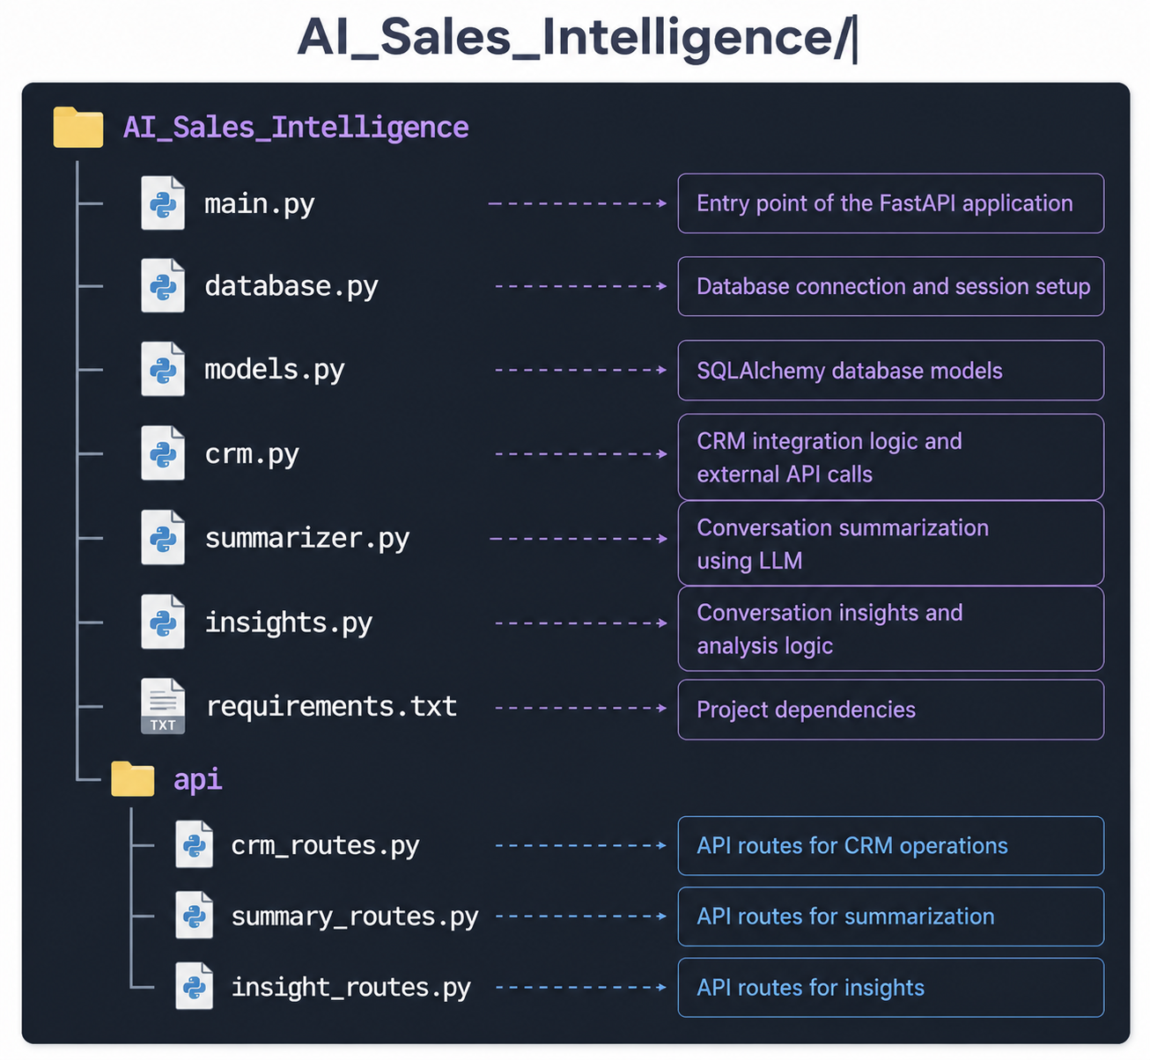
Folder Structure

Slide 25
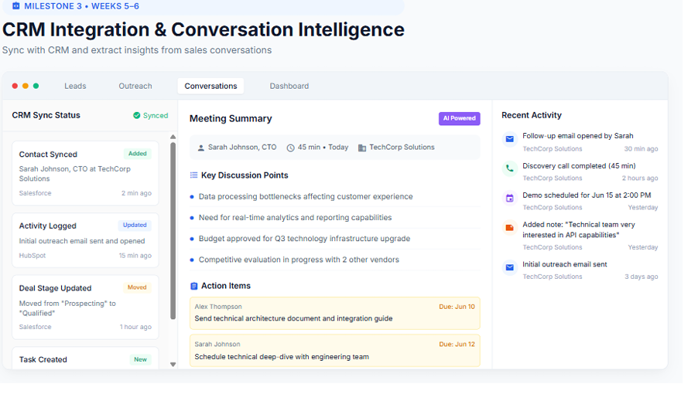

Slide 26
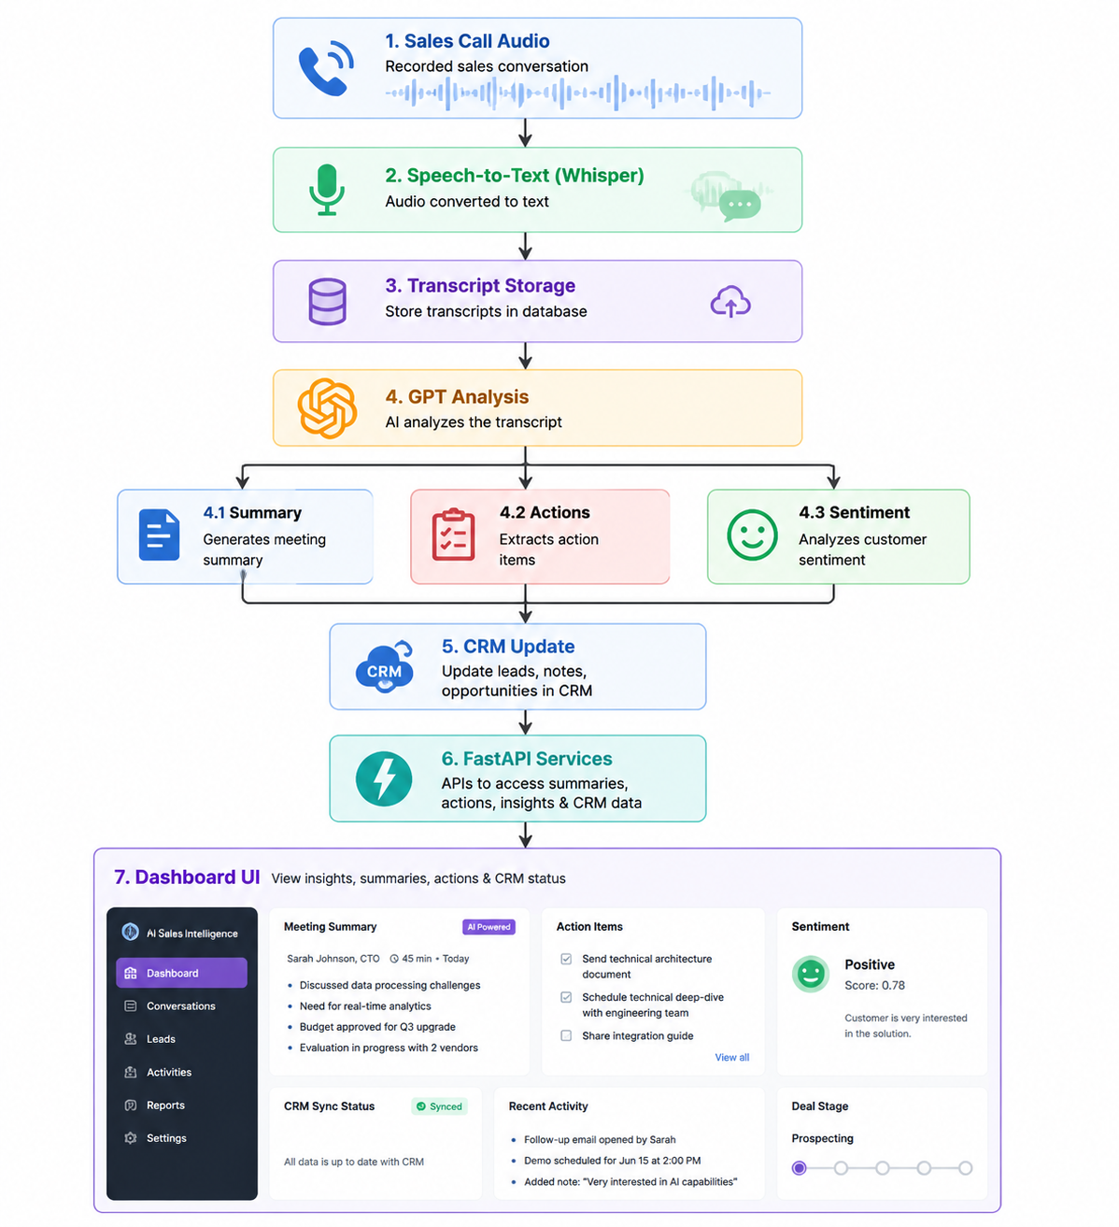

Slide 27
